Slide 1
Building Java Programs Chapter 1
Introduction to Java Programming

Slide 2
What is programming?
Program:A set of instructions to be carried out by a computer.
Program execution: The act of carrying out the instructions contained in a program.
Programming language: A systematic set of rules used to describe computations in a format that is editable by humans.
This textbook teaches programming in a language named Java.

Slide 3
Structure of a Java program
class: a program
public class name {
public static void main(String[] args) {
statement;
statement;
...
statement;
}
}
Every executable Java program consists of a class,
that contains a method named main,
that contains the statements (commands) to be executed.
method: a named group of statements
statement: a command to be executed

Slide 4
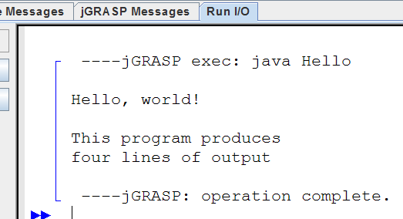
A Java program
public class Hello {
public static void main(String[] args) {
System.out.println("Hello, world!");
System.out.println();
System.out.println("This program produces");
System.out.println("four lines of output");
}
}
Its output:
Hello, world!
This program produces
four lines of output

Slide 5
Names and identifiers
You must give your program a name.
public class CSC1302{
Naming convention: capitalize each word (e.g.，MyClassName)
Your program's file must match exactly (CSC1302.java)
includes capitalization (Java is "case-sensitive")
Identifier: A name given to an item in your program.
must start with a letter or _ or $
subsequent characters can be any of those or a number
legal: _myName TheCure ANSWER_IS_42 $bling$
illegal: me+u 49ers side-swipe Ph.D's

Slide 6
Strings
String: A sequence of characters to be printed.
Starts and ends with a " quote " character.
The quotes do not appear in the output.
Examples: "hello" "This is a string. It's very long!"
Restrictions:
May not span multiple lines. "This is not a legal String."
May not contain a " character. "This is not a "legal" String either."

Slide 7
Escape sequences
Escape sequence: A special sequence of characters used to represent certain special characters in a string.
\t tab character
\n new line character
\" quotation mark character
\\ backslash character
Example: System.out.println("\\hello\nhow\tare \"you\"?\\\\");
Output: \hello how are "you"?\\

Slide 8
Comments
Comment: A note written in source code by the programmer to describe or clarify the code.
Comments are not executed when your program runs.
Syntax:
// comment text, on one line or, /* comment text; may span multiple lines */
Examples:
// This is a one-line comment.
/* This is a very long
multi-line comment. */

Slide 9
Static methods

Slide 10
Static methods
class
Static method: A named group of statements.
denotes the structure of a program
eliminates redundancy by code reuse
Procedural decomposition: dividing a problem into methods
Writing a static method is like adding a new command to Java.
method A
statement
statement
statement
method B
statement
statement
method C
statement
statement
statement

Slide 11
Using static methods
1. Design the algorithm.
Look at the structure, and which commands are repeated.
Decide what are the important overall tasks.
2. Declare (write down) the methods.
Arrange statements into groups and give each group a name.
3. Call (run) the methods.
The program's main method executes the other methods to perform the overall task.

Slide 12
Design of an algorithm
// This program displays a delicious recipe for baking cookies.
public class BakeCookies2 {
public static void main(String[] args) {
// Step 1: Make the cake batter.
System.out.println("Mix the dry ingredients.");
System.out.println("Cream the butter and sugar.");
System.out.println("Beat in the eggs.");
System.out.println("Stir in the dry ingredients.");
// Step 2a: Bake cookies (first batch).
System.out.println("Set the oven temperature.");
System.out.println("Set the timer.");
System.out.println("Place a batch of cookies into the oven.");
System.out.println("Allow the cookies to bake.");
// Step 2b: Bake cookies (second batch).
System.out.println("Set the oven temperature.");
System.out.println("Set the timer.");
System.out.println("Place a batch of cookies into the oven.");
System.out.println("Allow the cookies to bake.");
// Step 3: Decorate the cookies.
System.out.println("Mix ingredients for frosting.");
System.out.println("Spread frosting and sprinkles.");
}
}

Slide 13
Declaring a method
Gives your method a name so it can be executed
Syntax: public static void name() { statement; statement; ... statement; }
Example: public static void printWarning() { System.out.println("This product causes cancer"); System.out.println("in lab rats and humans."); }

Slide 14
Calling a method
Executes the method's code
Syntax:
name();
You can call the same method many times if you like.
Example:
printWarning();
Output:
This product causes cancer
in lab rats and humans.

Slide 15
Program with static method
public class FreshPrince {
public static void main(String[] args) {
rap(); // Calling (running) the rap method
System.out.println();
rap(); // Calling the rap method again
}
// This method prints the lyrics to my favorite song.
public static void rap() {
System.out.println("Now this is the story all about how");
System.out.println("My life got flipped turned upside-down");
}
}
Output:
Now this is the story all about how
My life got flipped turned upside-down
Now this is the story all about how
My life got flipped turned upside-down

Slide 16
Methods calling methods
public class MethodsExample {
public static void main(String[] args) {
message1();
message2();
System.out.println("Done with main.");
}
public static void message1() {
System.out.println("This is message1.");
}
public static void message2() {
System.out.println("This is message2.");
message1();
System.out.println("Done with message2.");
}
}
Output:
This is message1.
This is message2.
This is message1.
Done with message2.
Done with main.

Slide 17
Control flow
When a method is called, the program's execution...
"jumps" into that method, executing its statements, then
"jumps" back to the point where the method was called.
public class MethodsExample {
public static void main(String[] args) {
message1();
message2();
System.out.println("Done with main.");
}
...
}
public static void message1() {
System.out.println("This is message1.");
}
public static void message2() {
System.out.println("This is message2.");
message1();
System.out.println("Done with message2.");
}

Slide 18
When to use methods
Place statements into a static method if:
The statements are related structurally
The statements are repeated.
You should not create static methods for:
An individual println statement.
Only blank lines. (Put blank printlns in main.)
Unrelated or weakly related statements. (Consider splitting them into two smaller methods.)

Slide 19
Drawing complex figures with static methods

Slide 20
Static methods question
Write a program to print these figures using methods.
______
/ \
/ \
\ /
\______/
\ /
\______/
+--------+
______
/ \
/ \
| STOP |
\ /
\______/
______
/ \
/ \
+--------+

Slide 21
Development strategy
______
/ \
/ \
\ /
\______/
\ /
\______/
+--------+
______
/ \
/ \
| STOP |
\ /
\______/
______
/ \
/ \
+--------+
First version (unstructured):
Create an empty program and main method.
Copy the expected output into it, surrounding each line with System.out.println syntax.
Run it to verify the output.

Slide 22
Program version 1
public class Figures1 {
public static void main(String[] args) {
System.out.println(" ______");
System.out.println(" / \\");
System.out.println("/ \\");
System.out.println("\\ /");
System.out.println(" \\______/");
System.out.println();
System.out.println("\\ /");
System.out.println(" \\______/");
System.out.println("+--------+");
System.out.println();
System.out.println(" ______");
System.out.println(" / \\");
System.out.println("/ \\");
System.out.println("| STOP |");
System.out.println("\\ /");
System.out.println(" \\______/");
System.out.println();
System.out.println(" ______");
System.out.println(" / \\");
System.out.println("/ \\");
System.out.println("+--------+");
}
}
First version (unstructured):
Create an empty program and main method.
Copy the expected output into it, surrounding each line with System.out.println syntax.
Run it to verify the output.

Slide 23
Development strategy 2
______
/ \
/ \
\ /
\______/
\ /
\______/
+--------+
______
/ \
/ \
| STOP |
\ /
\______/
______
/ \
/ \
+--------+
Second version (structured, with redundancy):
Identify the structure of the output.
Divide the main method into static methods based on this structure.

Slide 24
Output structure
______
/ \
/ \
\ /
\______/
\ /
\______/
+--------+
______
/ \
/ \
| STOP |
\ /
\______/
______
/ \
/ \
+--------+
The structure of the output:
initial "egg" figure
second "teacup" figure
third "stop sign" figure
fourth "hat" figure
This structure can be represented by methods:
egg
teaCup
stopSign
hat

Slide 25
Program version 2
public static void stopSign() {
System.out.println(" ______");
System.out.println(" / \\");
System.out.println("/ \\");
System.out.println("| STOP |");
System.out.println("\\ /");
System.out.println(" \\______/");
System.out.println();
}
public static void hat() {
System.out.println(" ______");
System.out.println(" / \\");
System.out.println("/ \\");
System.out.println("+--------+");
}
}
public class Figures2 {
public static void main(String[] args) {
egg();
teaCup();
stopSign();
hat();
}
public static void egg() {
System.out.println(" ______");
System.out.println(" / \\");
System.out.println("/ \\");
System.out.println("\\ /");
System.out.println(" \\______/");
System.out.println();
}
public static void teaCup() {
System.out.println("\\ /");
System.out.println(" \\______/");
System.out.println("+--------+");
System.out.println();
}

Slide 26
Development strategy 3
______
/ \
/ \
\ /
\______/
\ /
\______/
+--------+
______
/ \
/ \
| STOP |
\ /
\______/
______
/ \
/ \
+--------+
Third version (structured, without redundancy):
Identify redundancy in the output, and create methods to eliminate as much as possible.
Add comments to the program.

Slide 27
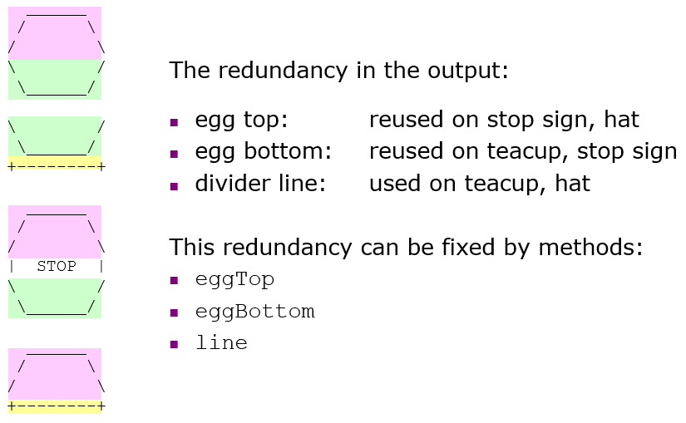
Output redundancy

Slide 28
Program version 3
public class Figures3 {
public static void main(String[] args) {
egg();
teaCup();
stopSign();
hat();
}
// Draws the top half of an an egg figure.
public static void eggTop() {
System.out.println(" ______");
System.out.println(" / \\");
System.out.println("/ \\");
}
// Draws the bottom half of an egg figure.
public static void eggBottom() {
System.out.println("\\ /");
System.out.println(" \\______/");
}
// Draws a complete egg figure.
public static void egg() {
eggTop();
eggBottom();
System.out.println();
}
// Draws a teacup figure.
public static void teaCup() {
eggBottom();
line();
System.out.println();
}
// Draws a stop sign figure.
public static void stopSign() {
eggTop();
System.out.println("| STOP |");
eggBottom();
System.out.println();
}
// Draws a figure that looks sort of like a hat.
public static void hat() {
eggTop();
line();
}
// Draws a line of dashes.
public static void line() {
System.out.println("+--------+");
}
}

